Slide 1

Introduction to NLP using PowerBI + R
Sponsored by:
Demo: text mining on #MeToo tweets
Notes:
Good evening everyone My name is Nujcharee or Ped @nujcharee and today I will give you a quick intro of NLP using PowerBI and R and how I applied this in my Data Journalism contest submission which happened earlier this year.

Slide 2

Hello world :)
Nujcharee Haswell (@nujcharee)
Data & Intelligence Specialist / Data Scientist
Skills: PowerBI, SQL, SSAS, DAX, R
Interests: Text Analytics, Machine Learning, Data Journalism, Data for social good
Notes:
Why #Metoo -

Slide 3

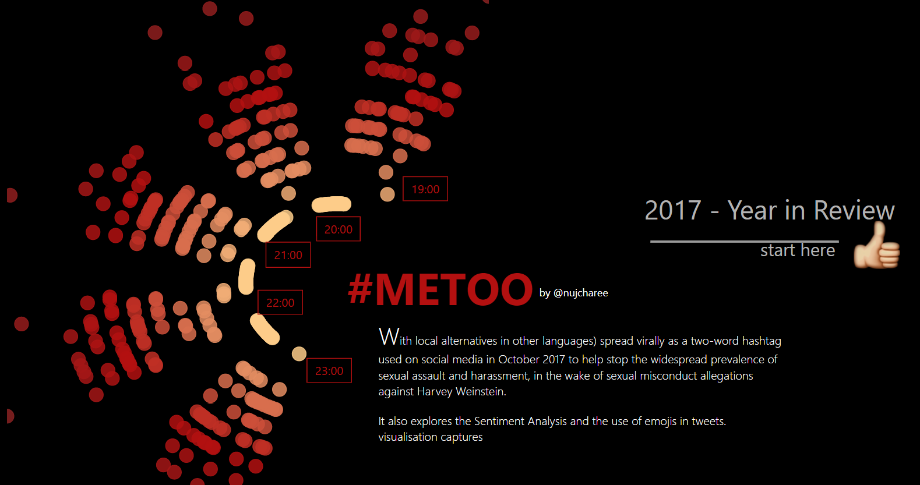
Year in Review Data Journalism - #MeToo Movement

Slide 4
Year in Review Data Journalism - #MeToo Movement
About the dataset
About 30K tweets with #MeToo hashtag
Some were geo-tagged
Contained tiny-urls, and needed major cleaning exercise

Slide 5

R is an open source statistical computing commonly used for statistical analysis and data mining.
NLP stands for Natural Language Processing, Use PowerBI for NLP tasks. This session will focus on text mining tasks.
Tidytext is a R package by Julia Silge & David Robinson. Use “Tidy data principles” to make text mining tasks possible in PowerBI
For more information check www.tidytextmining.com

Slide 6

Tidytext
Tidy approach definition
each variable is a column
each observation is a row
each type of observational unit is a table
Notes:
Tidy principle what i mean by that is that we transform the unstructured documents or text into columns and row so we can create measures and analyse it further. Thats what Tidy principle refers to.

Slide 7

Sample - PQ with R
tweetid | words
1 | 143
1 | days
1 | after
1 | revelations
1 | that
1 | Harvey
1 | Weinstein
1 | had
1 | been
1 | paying
1 | off
1 | sexual
Original tweet
library(tidytext)
library(stringr)
library(tidyverse)
……...
nrc = get_sentiments("nrc")
clean_metoo <- metoo %>%
mutate(linenumber = row_number(),
id = cumsum(str_detect(text, regex("^metoo [\\divxlc]", ignore_case = TRUE)))) %>% ungroup() %>% unnest_tokens(word, text) %>% anti_join(stop_words)

Slide 8
Step 1: Load data
Things you need
Go to data.world site and choose the dataset
If you don’t already have data.world account, can sign in using twitter account / github account
Click on Download, choose PowerBI
Good to go!!
Notes:
Tidy principle what i mean by that is that we transform the unstructured documents or text into columns and row so we can create measures and analyse it further. Thats what Tidy principle refers to.

Slide 9
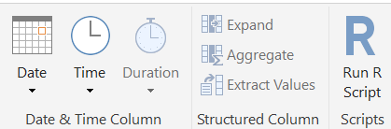
Step 2: Transform data with tidytext
In Power Query, choose R Script
R Editor window is prompted, by default the table is assigned as “dataset” dataframe.
R tasks!! - Tokenization task
Load ‘NRC lexicons. The nrc lexicon categorizes words in a binary fashion (“yes”/“no”) into categories of positive, negative, anger, anticipation, disgust, fear, joy, sadness, surprise, and trust. (tidytextmining.com)
Notes:
In Power Query Editor Screen (Those who arent on the latest PowerBI March release you will see this as Query Editor not Power Query Edtiro)

Slide 10
Step 2: Transform data with tidytext
Load NRC lexicon
library(tidytext)
nrc = get_sentiments("nrc")
Tokenising words (bi-gram)
df_bigram = dataset %>% unnest_tokens(bigram, text, token = "ngrams", n = 2)
Word pairs / correlations
df_bigram %>% count(bigram, sort = TRUE) bigrams_separated <- df_bigram %>% separate(bigram, c("word1", "word2"), sep = " ")
Notes:
In Power Query Editor Screen (Those who arent on the latest PowerBI March release you will see this as Query Editor not Power Query Edtiro)

Slide 11
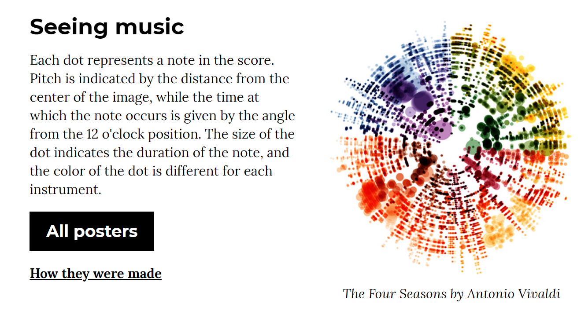

Step 3: Visualising data
Scatterplot - inspired by ggplot visualisation by Nicholas Rougeux
Custom visuals - e.g play axis to create animations - available in Microsoft Store
Notes:
I’ve been a fan of Nicholas’s visualisation piece here and Ive seen people having a go recreating this using R and ggplot2 (which is a visualisation package most popular package may I say) and I thought surely we can do this in powerBI so I actually use generic scatter plot to do this. Not exactly the same but I am happy with jmy result.

Slide 12
Conclusion
NLP text mining task is easily implemented using PQ + R
If you love SQL you would love tidytext and tidy data principles
Quick insight of textual data
Notes:
Tidy principle what i mean by that is that we transform the unstructured documents or text into columns and row so we can create measures and analyse it further. Thats what Tidy principle refers to.

Slide 13
Thank you!!!
Here are useful links
http://community.powerbi.com/t5/Data-Stories-Gallery/MeToo-Year-in-Review/m-p/337846#M1477
www.tidytextmining.com
https://azure.microsoft.com/en-gb/try/cognitive-services/
Github: https://github.com/nujcharee/PowerBI/blob/master/metoo2.pbix

